Slide 1
Software Design Pattern
COMMAND

Slide 2
What is Software design Pattern?
*A general reusable solution to a commonly occurring problem within a given context in software design.
*Not a finished design
* Can’t be transformed directly into source code.
Example
Command, Adapter, Bridge etc.

Slide 3
What is a Command design pattern?
*Encapsulate a request as an object, thereby letting you parameterize clients with different requests, queue or log requests, and support undoable operations.

Slide 4
Some characterstics
*Decouples the object that invokes the operation from the one that knows how to perform it.
*First class object
* Can be manipulated and extended like any other object.
* Easy to add new commands
* No need to change existing class.
* Has the ability to undo a command though all the previous steps need to be saved.

Slide 5
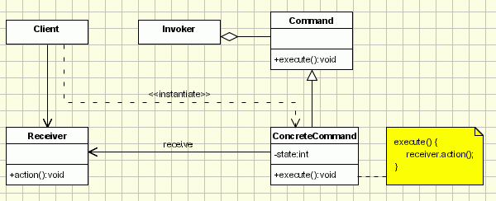
Structure & Implementation

Slide 6
Structure & Implementation
The classes participating in the pattern are:
- Command - declares an interface for executing an operation; - ConcreteCommand - extends the Command interface, implementing the Execute method by invoking the corresponding operations on Receiver. It defines a link between the Receiver and the action. - Client - creates a ConcreteCommand object and sets its receiver; - Invoker - asks the command to carry out the request; - Receiver - knows how to perform the operations.

Slide 7
Structure & Implementation
The Client asks for a command to be executed. The Invoker takes the command, encapsulates it and places it in a queue, in case there is something else to do first, and the ConcreteCommand that is in charge of the requested command, sending its result to the Receiver.

Slide 8
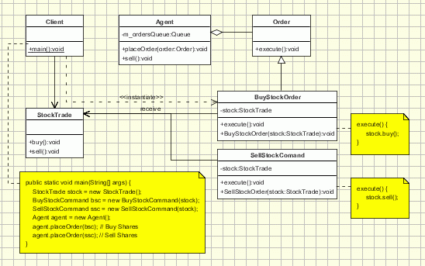
Structure & Implementation
Sample UML diagram of a classic implementation of this pattern for placing orders for buying and selling stocks

Slide 9
Real life Uses
GUI buttons and menu items
Wizards
Networking
Progress bar
And many others…….

Slide 10
In Summary….
We should go with Command pattern when we have multiple command to execute even they don’t relate with each other.

